Slide 1
MARBEL - Basics
Multi-Agent Systems
Practical 5

Slide 2
EXERCISE 1
Collecting information from the agent console window in the debugging perspective.
Objective: To learn to collect and understand basic information about an how agent is executed by inspecting the agent console.

Slide 3
Exercise 1a
Start the HelloWorld ScriptAgent mas file in debug mode.
At the start, what is the content of the agent’s database (mental state)?
By stepping into the code, in the first cycle, which (variable) bindings are retrieved for the variables in the action rule?
Tip: inspect the Evaluation console

Slide 4
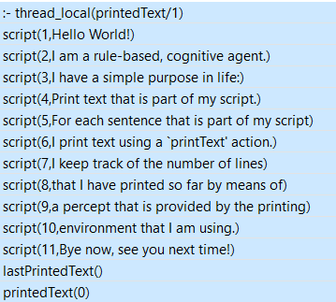
Exercise 1a
Content of the initial database:

Slide 5
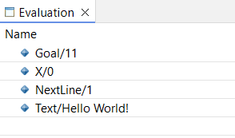
Exercise 1a
Variable bindings in first cycle for action rule:
To get these, step into the module

Slide 6
Exercise 1b
Start the ScriptAgent mas file in debug mode.
By stepping through the code, collect all information from the agent console, until the agent terminates.
Tip: Set MARBEL logging preferences and select option Built-in actions that have been executed!

Slide 7
School Solution 1b
The agent console output should look like:
[helloWorldAgent] starting agent.
[helloWorldAgent] inserted ':- thread_local(printedText/1), script(1,Hello World!), script(2,I am a rule-based, cognitive agent.), script(3,I have a simple purpose in life:), script(4,Print text that is part of my script.), script(5,For each sentence that is part of my script), script(6,I print text using a `printText' action.), script(7,I keep track of the number of lines), script(8,that I have printed so far by means of), script(9,a percept that is provided by the printing), script(10,environment that I am using.), script(11,Bye now, see you next time!)'.
[helloWorldAgent] +++++++ Cycle 1 +++++++
[helloWorldAgent] inserted 'lastPrintedText(), printedText(0)'.
[helloWorldAgent] started agent (took 15ms).
[helloWorldAgent] performed 'printText(Hello World!)'.
[helloWorldAgent] +++++++ Cycle 2 +++++++
[helloWorldAgent] inserted 'lastPrintedText(Hello World!), printedText(1)'and deleted 'lastPrintedText(), printedText(0)’.
…

Slide 8
School Solution 1b
[helloWorldAgent] performed 'printText(I am a rule-based, cognitive agent.)'.
[helloWorldAgent] +++++++ Cycle 3 +++++++
[helloWorldAgent] inserted 'lastPrintedText(I am a rule-based, cognitive agent.), printedText(2)'and deleted 'lastPrintedText(Hello World!), printedText(1)'.
User started me. (DEPENDS ON HOW THE AGENT WAS RUN!!)
[helloWorldAgent] performed 'printText(I have a simple purpose in life:)'.
[helloWorldAgent] +++++++ Cycle 4 +++++++
[helloWorldAgent] inserted 'lastPrintedText(I have a simple purpose in life:), printedText(3)'and deleted 'lastPrintedText(I am a rule-based, cognitive agent.), printedText(2)'.
[helloWorldAgent] performed 'printText(Print text that is part of my script.)'.
[helloWorldAgent] +++++++ Cycle 5 +++++++
[helloWorldAgent] inserted 'lastPrintedText(Print text that is part of my script.), printedText(4)'and deleted 'lastPrintedText(I have a simple purpose in life:), printedText(3)’
…

Slide 9
School Solution 1b
[helloWorldAgent] performed 'printText(For each sentence that is part of my script)'.
[helloWorldAgent] +++++++ Cycle 6 +++++++
[helloWorldAgent] inserted 'lastPrintedText(For each sentence that is part of my script), printedText(5)'and deleted 'lastPrintedText(Print text that is part of my script.), printedText(4)'.
[helloWorldAgent] performed 'printText(I print text using a `printText' action.)'.
[helloWorldAgent] +++++++ Cycle 7 +++++++
[helloWorldAgent] inserted 'lastPrintedText(I print text using a `printText' action.), printedText(6)'and deleted 'lastPrintedText(For each sentence that is part of my script), printedText(5)'.
[helloWorldAgent] performed 'printText(I keep track of the number of lines)'.
[helloWorldAgent] +++++++ Cycle 8 +++++++
[helloWorldAgent] inserted 'lastPrintedText(I keep track of the number of lines), printedText(7)'and deleted 'lastPrintedText(I print text using a `printText' action.), printedText(6)’.
…

Slide 10
School Solution 1b
[helloWorldAgent] performed 'printText(that I have printed so far by means of)'.
[helloWorldAgent] +++++++ Cycle 9 +++++++
…
…
[helloWorldAgent] +++++++ Cycle 11 +++++++
[helloWorldAgent] inserted 'lastPrintedText(environment that I am using.), printedText(10)'and deleted 'lastPrintedText(a percept that is provided by the printing), printedText(9)'.
[helloWorldAgent] performed 'printText(Bye now, see you next time!)'.
[helloWorldAgent] +++++++ Cycle 12 +++++++ (SHOULD BE 12 CYCLES)
[helloWorldAgent] inserted 'lastPrintedText(Bye now, see you next time!), printedText(11)'and deleted 'lastPrintedText(environment that I am using.), printedText(10)'.

Slide 11
EXERCISE 2
Changing the output of the script agent by adding line number prefixes.
Objectives:
To understand basic information that is in the code.
To learn where different parts of the code are located, and where to change code.
To learn how to use Prolog queries using a predefined, built-in SWI predicate and to introduce new variables to shape the input of an action parameter of a MARBEL agent.

Slide 12
Exercise 2a
Inspect the code of the ScriptAgent mas:
What is the name of the agent defined in this mas?
Which module(s) is used by this agent?
Why is the module parameter set to 11 in the agent definition?
What action is being used by this agent? What type of action is this (built-in or environment action)?

Slide 13
School Solution 2a
The agent’s name is: helloWorldAgent
One decision module is used: printScript
The module parameter is set to 11 because there are 11 lines to be printed in the script.pl file.
The agent used one action: printedText(X).
It is an environment action, defined by the HelloWorldEnvironment-1.3.0.jar environment

Slide 14
Exercise 2b
Change the ScriptAgent mas and make sure that it will print 12 lines instead of 11 by printing an additional line between the original line 10 and 11. Content of what is printed is up to you!

Slide 15
School Solution 2b
Code in the script.pl file needs to be changed. Code should like something like:
script(10, "environment that I am using.").
script(11, “THIS IS A NEW LINE THAT WAS NOT THERE BEFORE").
script(12, "Bye now, see you next time!").

Slide 16
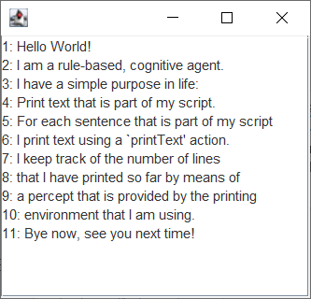
Exercise 2c
Change the code of the agent such that it prefixes each line that is printed with a corresponding number. Output should look like:
Tip: Use the built-in SWI predicate string_concat/3.
See: https://www.swi-prolog.org/pldoc/man?predicate=string_concat/3.

Slide 17
School Solution 2c
The action rule in the printScript module needs to be changed to something like this:
if printedText(X), X < Goal, NextLine is X+1, script(NextLine, Text),
string_concat(NextLine, ": ", LinePrefix),
string_concat(LinePrefix, Text, Output)
then printText(Output).
Key is to make sure that new variables to store “in between” results are introduced.
Also, of course, the action parameter of the printText action needs to be changed.

Slide 18

BLOCKS WORLD AGENT
Recap of main ideas behind the code design of the agent.

Slide 19
EXERCISE 3
Extending the Blocks World solution to be able to also handle blocks that are not part of the goal state but are blocking access to blocks that are needed for achieving the goal state.
Objective: To learn how to extend the reasoning powers of an agent (by extending the Prolog code) to handle situations it could not handle before.
Notes:
This is an adapted version of the Exercise 3.9.2 in the MARBEL programming guide.

Slide 20
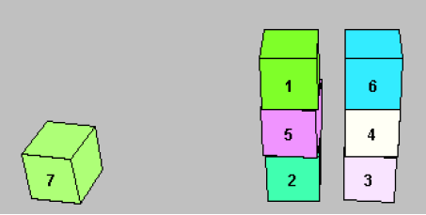
Blocks that are not part of the goal
Does our agent solve all Blocks World configurations?
Suppose we have Goal=[table,b1,b2]
Are blocks b4, b5, b6 misplaced?
Think about a solution. Hint: define above(X, Y)
Initial state
HOMEWORK ASSIGNMENT:
Notes:
This is a copy of a slide used in Lecture 3 to introduce the problem we aim to address in the first Exercise.

Slide 21
Issue with our misplaced DF
We defined misplaced(X) by the query:
If this is our initial state:
and the goal is:
[table,b1,b2]
Then: b4, b5, b6 are not misplaced because they are not part of the goal state.
E.g., tower([table,b1,b2], [b4|T]) does not succeed…
tower(Goal, [X|T]), not(tower([X|T])), clear(X), not(on(X,table))
Initial state
Notes:
To be able to infer from the database that a block such as b4 is misplaced we must be able to infer the first part of the misplaced query: tower(Goal, [X|T]). But we cannot do that for b4, b5, b6 because none of these blocks are part of the goal state…
If students don’t see how that works with the Prolog query, tell them to go back to the Prolog definitions for these predicates and evaluate those by hand or by creating an agent with the illustrated initial state and the goal state on this slide (and use the Interactive console to evaluate things on the database).

Slide 22
Exercise 3a: Problem (first step)
Define constructive and misplaced. In blocksworld.pl, add the following definitions:
Use these definitions in the stackBuilder module.
Run code in debugging mode, select module, and step through it F5 to see what happens.
constructiveMove(Goal, X, Y) :-
tower(Goal, [X,Y | T]), tower([Y| T]), clear(X), clear(Y).
misplaced(Goal, X) :-
tower(Goal, [X | T]), not( tower([X | T]) ),
clear(X), not( on(X, table) ).
Notes:
Let’s make a first step to fix this by solving this problem.
Tip: comment out (old) code using % (so old action rule code in module need not be deleted).

Slide 23
Exercise 3a: Solution
…
[stackBuilderAgent] +++++++ Cycle 1 +++++++
[stackBuilderAgent] inserted 'on(b1,b2), on(b2,b3), on(b3,table), on(b4,b5), on(b5,table), on(b6,b7), on(b7,table)'.
[stackBuilderAgent] started agent (took 31ms).
[stackBuilderAgent] performed 'move(b1, table)'.
[stackBuilderAgent] +++++++ Cycle 2 +++++++
[stackBuilderAgent] inserted 'on(b1,table)'and deleted 'on(b1,b2)'.
[stackBuilderAgent] performed 'move(b2, table)’.
…
[stackBuilderAgent] +++++++ Cycle 6 +++++++
[stackBuilderAgent] inserted 'on(b1,b5)'and deleted 'on(b1,table)'.
[stackBuilderAgent] performed 'move(b6, b4)'.
[stackBuilderAgent] +++++++ Cycle 7 +++++++
[stackBuilderAgent] inserted 'on(b6,b4)'and deleted 'on(b6,b7)'.
Notes:
Part of the agent console’s log of what happened. Agent using our definitions achieves the goal!
In other words, we have a working agent, we’ll change it in the next few steps but should make sure at the end it works again ;-).

Slide 24
Exercise 3b: Problem
Define a recursive Prolog predicate above in the Prolog file blocksworld.pl.
above(X, Y) should succeed when X sits above another block Y. So, if X sits directly on Y it above(X, Y) should succeed. above(X, Y) should also succeed when X sits on top of another block that sits above Y.

Slide 25
Exercise 3b: Solution
Introduce the following Prolog clauses:
Clearly, a block sits above another block if it directly sits on top of it (clause 1).
A block X also sits above another one Z if it sits directly on top of Y which sits above Z (clause 2).
NB: use tail recursion.
See also: Learn Prolog Now
above(X, Y) :- on(X, Y), block(Y).
above(X, Z) :- on(X, Y), above(Y, Z).
Notes:
Tail recursion is needed: above(X, Z) :- on(X, Y), above(Y, Z). Clearly, above(X, Z) :- above(Y, Z), on(X, Y). does not work (no termination)!

Slide 26
Exercise 3c: Problem
Create a new, second Prolog rule that defines when a block that is not part of the goal is misplaced.
Run your agent with following changes in mas:
start = [2, 3, 0, 5, 0, 4, 1]
stackBuilder([b4, table, b2, b3])
What does it do? Can it handle blocks that are not part of the goal correctly?

Slide 27
Exercise 3c: Solution
The second rule:
This rule is almost an exact copy of the first rule for misplaced but the above predicate has been added as the first subquery at the start; also note the variable name has been changed for convenience; and we do not check any more that Z is not already on the table because we already know because of above/2.
misplaced(Goal, Z) :-
above(Z, X),
tower(Goal, [X | T]), not( tower([X | T]) ), clear(Z).

Slide 28
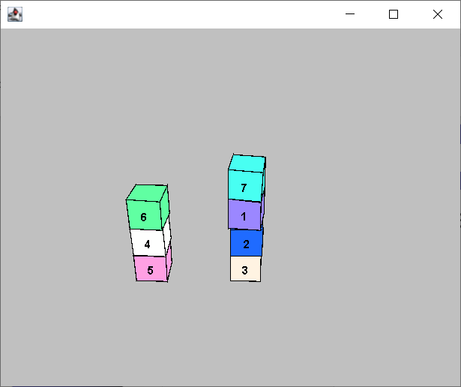
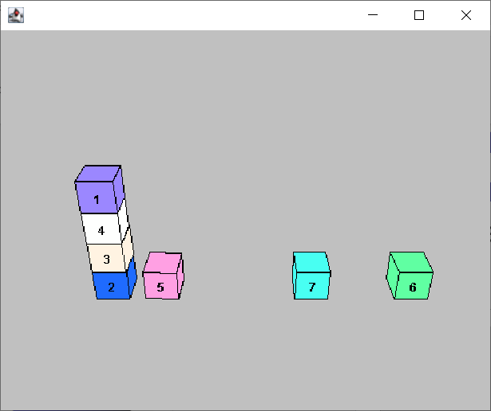
Exercise 3c: Solution
What does the agent do?
Initial state
Goal state

Slide 29
Exercise 3d: Problem
Would a similar solution also work for the Tower World we developed in the lecture?
Try this at home!
Notes:
Yes it would. Can reuse df of above predicate. Same strategy would work for adapting the misplaced predicate.

Slide 30
EXERCISE 4
Implementing a straightforward strategy for solving Blocks World problems: first moving all blocks to the table, and only after that has been done building the goal tower stacks of blocks. We call this the “basic strategy”.
Objective: To learn how to control rule evaluation using multiple modules (instead of one) and the exit option of a module.
Notes:
This is an adapted version of Exercise 3.9.3 in the MARBEL programming guide.

Slide 31
Exercise 4a: Intro
The current code for the Blocks World agent heavily relies on the tower/2 and tower/3 predicates. If we first move all blocks to the table, and then start building the stacks of blocks we want, these definitions are not needed (think about it!).

Slide 32
Exercise 4a: Problem
Let’s try and see what happens if we implement the “basic strategy” literally…
Start by simplifying the Prolog code: remove all tower-related predicates from the Prolog file.
Make sure that the Prolog file does not give any compile errors anymore; don’t change any other files yet. Which compile errors do you get?

Slide 33
Exercise 4a: Solution
Check out the Problems console in Eclipse:
Description Resource Path Location Type
'constructiveMove(Goal,X,Y)' is not defined stackBuilder.mod2g line 10
'misplaced(Goal,X)' is not defined … stackBuilder.mod2g line 14

Slide 34
Exercise 4b: Problem
Fix the issues in the stackBuilder module by:
removing the action rules;
inspecting the clearBlocks module;
adding a use clause for that module:
use clearBlocks.
adding an action rule that uses this module:
if <QUERY> then clearBlocks.
QUERY should check there (still) is a block on another one.
Step through the code & check what it does.
Notes:
The Blocks World project comes with a predefined clearBlocks module that can be used.

Slide 35
Exercise 4b: Solution
The action rule query should look like:
if on(_, Y), block(Y) then clearBlocks.
Or, alternatively:
if block(X), not( on(_, X) ) then clearBlocks.
would, for example, also work.
NB:
use don’t care to avoid warnings in Eclipse.
instantiate vars before using them in negation
Notes:
Just using not( on(_, X) ) might end up in what is called floundering… An issue that results in unexpected behaviour of the negation…

Slide 36
Exercise 4b: Solution
[stackBuilderAgent] starting agent.
…
[stackBuilderAgent] +++++++ Cycle 1 +++++++
[stackBuilderAgent] inserted 'on(b1,b2), on(b2,b3), on(b3,table), on(b4,b5), on(b5,table), on(b6,b7), on(b7,table)'.
[stackBuilderAgent] started agent (took 15ms).
User started me.
[stackBuilderAgent] empty update.
[stackBuilderAgent] performed 'move(b1, table)’.
…
[stackBuilderAgent] +++++++ Cycle 5 +++++++
[stackBuilderAgent] inserted 'on(b6,table)'and deleted 'on(b6,b7)'.
[stackBuilderAgent] empty update.
Agent moved b1, b2, b4, and b6 to table. See also agent’s database, all blocks on table!

Slide 37
Exercise 4c: Problem
The agent, however, does not “stay” in the module clearBlocks. We can change that by adding an exit option:
Add: exit=noaction. to the module.
Step through the code & check what it does.

Slide 38
Exercise 4c: Solution
Agent moved b1, b2, b4, and b6 to table. See also agent’s database, all blocks on table!
The agent, however, never exits the clearBlocks module while there are still blocks that can be moved to the table.
NB: You can make this visible in the agent’s log by changing the log preferences (check entry and exit module items).

Slide 39
Exercise 4d: Problem
Add an action rule to the stackBuilder module that will constructively move blocks onto other blocks again.
Run your agent: what is the problem?

Slide 40
Exercise 4d: Solution
The new rule should include action preconditions.
When the rule is added after the other rule, all blocks are moved to the table and then b1 is moved onto b5 and then moved back to the table again. Etc.
When the rule is added before the other rule, first b6 is moved onto b4, then all blocks are moved to the table, and then the agent is killed.
module stackBuilder(Goal) {
if on(_, Y), block(Y) then clearBlocks.
if on(Goal, X, Y), clear(X), clear(Y) then move(X, Y).
}
module stackBuilder(Goal) {
if on(Goal, X, Y), clear(X), clear(Y), not(Y=table)
then move(X, Y).
if on(_, Y), block(Y) then clearBlocks.
}
Notes:
There are, of course, many other things students could have done. For example, the not(Y=table) could not have been added to the rule. Then the agent keeps making ‘constructive moves’ by also moving b7 to the table again and again (which is funny because it keeps moving on the ‘table’).
NOTA BENE: The rule added here is NOT the correct one yet and will need to be fixed later. The issue is that the rule does not yet address the Sussman anomaly (see earlier slide). The rule is introduced here as a (natural) stepping stone to make progress towards the final solution. It is only naturally that while coding issues pop up that need to be ‘discovered’ and resolved through debugging, which we will ask students to do later as a final step (Exercise 1f).

Slide 41
Exercise 4e: Problem
Fix the problem by:
introducing another new module that you call buildStacks;
moving the action rule for making constructive moves into that module;
adding a rule that selects this module in the stackBuilder module (after the first rule).
Make sure it also only exits when there are no more constructive moves to make.
Run your agent again. What does it do?

Slide 42
Exercise 4e: Solution
The module to be added:
NB: the Goal parameter; the exit=noaction ; the use clause for a Prolog file is needed here too.
The rule to be added (last) to the stackBuilder module:
use blocksworld.
exit=noaction.
module buildStacks(Goal) {
if on(Goal, X, Y), clear(X), clear(Y), not(Y=table)
then move(X, Y).
}
if true then buildStacks(Goal).
Notes:
This may take students quite some time.

Slide 43
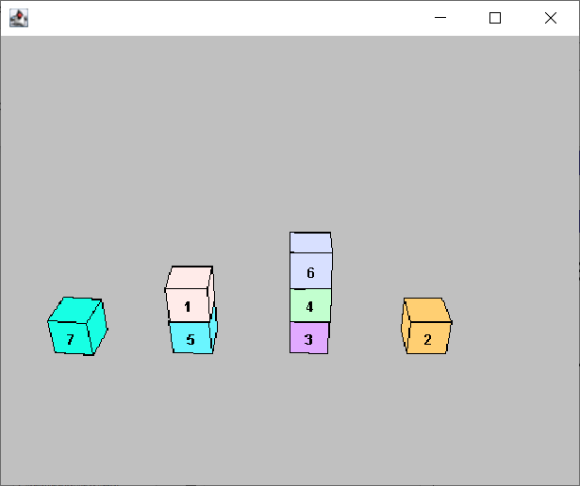
Exercise 4e: Solution
What does it do?
The agent first moves all blocks to the table. Then starts stacking by first moving b1 on b5, b4 on b3, b6 on b4, and then is killed.
Issue: b5 should be on b2 but cannot be moved any more. We still need to address the Sussman anomaly!!
Notes:
We are not using the tower predicate anymore to maintain a ‘global’ sense of progress and the rule we introduced only looks at subgoal progress (which block should be on another, instead of what final tower starting from the table(!) do we need to have). So, in a sense, even though the agent first moves all blocks to the table, we still face an issue related to the Sussman anomaly discussed earlier.

Slide 44
Exercise 4f: Problem
Fix the issue with the action rule in the buildStacks module to make constructive moves.
Hint: You need to add a condition that checks that Y is already where it needs to be (a job the tower predicate we removed did in the original agent).
Run the agent and check whether it now works.

Slide 45
Exercise 4f: Solution
We add the (sub)query on(Goal,Y,Z), on(Y,Z) which checks that (block) Y is already where it needs to be (it is where we want it to be):
We also removed not(on(Y, table)). Why is no longer needed?
if on(Goal, X, Y), on(Goal, Y, Z), on(Y, Z), clear(X), clear(Y)
then move(X, Y).

Slide 46
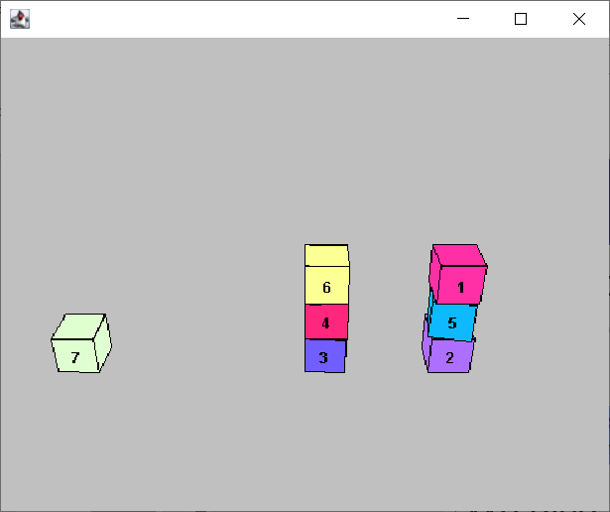
Exercise 4f: Solution
What does the agent do? It achieves its goal: [b5, table, table, b3, b2, b4, table].

